Slide 1

Parallel Runtime Analysis for Game of Life
By: Michael Giovenco

Slide 2
Introduction
For my project, I attempted to add parallelization to the Game of Life.
The Game of Life is the cellular life simulation game invented by John Horton Conway in 1970.
It is a 0 player game, played on a two-dimensional game board, that simulates cells life, replication, and death with a built in rule system that governs everything.
Many different patterns and simulation results are possible as a result of variables like number of initial cells and starting location of cells.

Slide 3
Game of Life Rules
Any live cell with fewer than two live neighbours dies, as if caused by underpopulation.
Any live cell with two or three live neighbours lives on to the next generation.
Any live cell with more than three live neighbours dies, as if by overpopulation.
Any dead cell with exactly three live neighbours becomes a live cell, as if by reproduce.

Slide 5
Why I chose this Algorithm?
To see if it was possible to add parallelism without impacting the game state.
To see how much increased performance I could add by running the program in parallel.
Because it genuinely is a cool game to code and play with.

Slide 6
Approach to this Problem
Initially, I created code that would run in serial and print out a game board after a each “life cycle”.
I chose to start with a pattern called a “blinker” that would simply alternate like the flipping of a tetris rectangle block.
This would allow me to know quickly after execution if the cells behaved according to the rules.

Slide 8
Enter OpenMP
To introduce this parallelism, I decided to attempt to add the techniques we learned in HW #2 using OpenMP.
I liked this approach as it allowed me the ability to start with clean working serial design to modify.
Also, allowed quick testing of changes to determine performance impact.

Slide 9
Code Modifications and Impact (1)
The first function I attempted to modify was the iterate function.
This could be considered the “outermost loop” of the program as it controls the game throughout its lifecycles.
I discovered changes here had consequences on the overall board (data corruption).
As result, no change was made.
void GameOfLife::iterate( unsigned int n ) {
// Change attempted here
for ( int i = 0; i < n; i++ ) {
print();
update();
}
}

Slide 10
Code Modifications and Impact (2)
The second function I attempted to modify was the print function.
This function prints the game board.
I attempted to apply #pragma omp for loops (or the for loop with collapse).
However, speed improvements were not seen at all with this approach regardless of thread or iteration size.
As result, no change was made.
void GameOfLife::print() {
if ( toggle ) {
// Change attempted here
for ( char i = 0; i < HEIGHT; i++ ) {
for ( char j = 0; j < WIDTH; j++ ) {
std::cout << board[i][j];
}
std::cout << std::endl;
}
} else {
// Change attempted here
for ( char i = 0; i < HEIGHT; i++ ) {
for ( char j = 0; j < WIDTH; j++ ) {
std::cout << otherBoard[i][j];
}
std::cout << std::endl;
}
}

Slide 11
Code Modifications and Impact (3)
The third function I attempted to modify was the update function.
This is the function that actually updates the board to the next state.
I was able to successfully add #pragma omp parallel and #pramga omp for to both iterations.
Data integrity was protected by using two boards.
However, only a slight performance improvement was noticed.
void GameOfLife::update() {
if (toggle) {
#pragma omp parallel
for ( char i = 0; i < HEIGHT; i++ ) {
#pragma omp for
for ( char j = 0; j < WIDTH; j++ ) {
otherBoard[i][j] =
GameOfLife::getState(board[i][j] , i , j , toggle);
}
}
toggle = !toggle;
} else {
#pragma omp parallel
for ( char i = 0; i < HEIGHT; i++ ) {
#pragma omp for
for ( char j = 0; j < WIDTH; j++ ) {
board[i][j] =
GameOfLife::getState(otherBoard[i][j] , i , j , t…

Slide 12
Code Modifications and Impact (4)
The final function I attempted to modify was the getState function.
This function is meant to calculate the number of neighbors for each cell to determine its next state.
Decided to use a #pragma omp with reduction on the neighbors count variable as this was a variable outside the for loop.
Data integrity was maintained with this change.
However, only a slight performance improvement was noticed.
char GameOfLife::getState( char state, char yCoord, char xCoord, bool toggle ) {
char neighbors = 0;
#pragma omp parallel
{
if ( toggle ) {
#pragma omp for reduction(+:neighbors)
for ( char i = yCoord - 1; i <= yCoord + 1; i++ ) {
for ( char j = xCoord - 1; j <= xCoord + 1; j++ ) {
if ( i == yCoord && j == xCoord ) {
continue;
}
if ( i > -1 && i < HEIGHT && j > -1 && j < WIDTH ) {
if ( board[i][j] == 'X' ) {
neighbors++;
}
}
}
}

Slide 13
Results and Performance
My initial goal of being able to parallelize the Game of Life was successful.
I tested running between 1-64 threads with no data integrity issues.
However, the performance improvements were much less than expected.
My theory on this is that this algorithm is already relatively fast when running serially.
There are no hard computations in the game (just needs to check its neighbors to determine next state).
So this means, the cost of spinning up additional threads might be worse than the performance speed gains from additional threads.

Slide 14
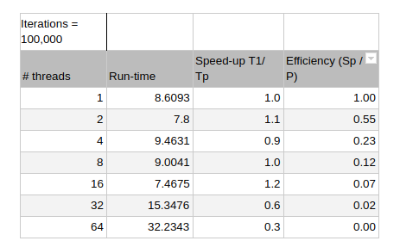
Speed-up and Efficiency

Slide 15
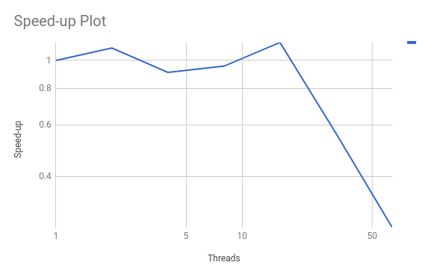
Speed-up Plot

Slide 16
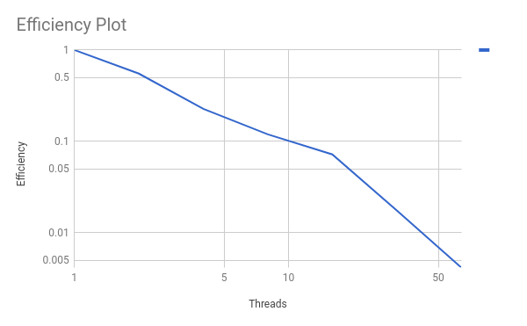
Efficiency Plot

Slide 17
Lessons Learned
Game of Life is possible to run in a multi-threaded fashion.
OpenMP allows you to add parallelism to accomplish this.
Performance gains appear limited, possibly do to relatively simple computational nature of the game.
Would have liked to test this with a much larger game board (100k-by-100k)
But serial runs would have been extremely slow for a comparison case.

